Slide 1
Uncontrolled copy not subject to amendment
Basic Navigation Using Map and Compass

Slide 2
Basic Navigation Using Map and Compass
Learning Outcome 2:
Know the different types of north

Slide 3
True / Grid / Magnetic North
True North and South are at the geographical poles.
Grid North is the direction to which all Ordnance Survey Maps are oriented. We take our map bearings using Grid North.
Magnetic North is the direction a compass points to and in the UK it is located approximately 5º West of Grid North.

Slide 4
Magnetic Variation
It is important to understand the relationship between Grid & Mag north as this will become important when we start to convert bearings to and from a map.
True North
Grid North
Magnetic North
4º

Slide 5
Magnetic Variation
True North
The difference in degrees between Magnetic (Mag) North and Grid North is referred to as the Magnetic Variation (usually 5º West in UK.)
Grid North
Magnetic North
5º

Slide 6
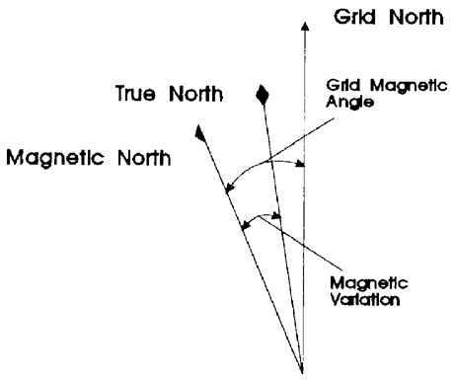
Magnetic North
The 3 North Poles as shown on an OS map

Slide 7
Magnetic North

